Slide 1
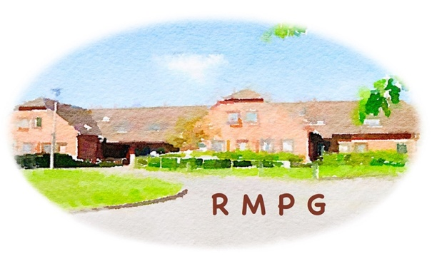
Rectory Meadow Patients Group General Meeting 15 February 2022
Welcome

Slide 2
Rectory Meadow Patients Group General Meeting Agenda 15 February 2022
Apologies for Absence
Approval of November 2021 minutes
Primary Care Network
Bobby Pozzoni-Child
Julie Dennis
Surgery Updates
Member Experiences
Health Awareness Events
Spring 2022 - “How Digital Technology will change our management of health care”
A.O.B.
Hobbs & repeat prescriptions
Newsletter
Next meeting
AGM Tuesday 17 May 2022

Slide 3
Rectory Meadow Surgery PPG
15th February 2022

Slide 4
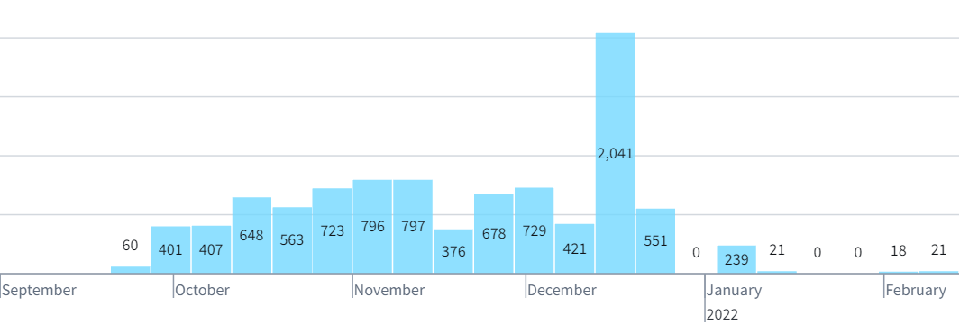
Covid Vaccinations – Phase 3
Rectory Meadow Surgery vaccinated 3,304 of their patients
The Mid Chilterns PCN Vaccinated nearly 9,500 patients since December.
5-11 year olds with Underlaying Health Conditions & Household contacts of Immunosuppressed

Slide 6
Pharmacy Team - DOAC QIS – 21/22
DOACs now being initiated in Primary Care. Training provided in the PCN.
Audited all DOAC doses to ensure up to date weight and CRCL
Reviewed patients doses, conditions etc and set patients up with date reviews due and scheduled using scheduled Accurx Florey.
DOAC Audit | AHC | RMS | HVS | JHS | PHS | PCN
No Of Patients | 242 | 252 | 376 | 79 | 75 | 1024
No Of Patients Reviewed | 216 | 198 | 334 | 63 | 71 | 882
No Of Patients not reviewed | 26 | 54 | 42 | 16 | 4 | 142
IIF 22/23 indicator SMR-03: Percentage of patients prescribed a direct oral anti-coagulant, who received a renal function test and a recording of their weight and Creatinine Clearance Rate, along with a change or confirmation of their medication dose.

Slide 7
Social Prescribing

Slide 8
Social Prescribing - Memory Support Service
Due to the cessation of the pilot, as of 1st December, the Memory Support Service is no longer able to accept memory screening referrals from GP Surgeries.
Social Prescribers have completed some online training run by the Alzheimer’s society and can offer this service across the PCN surgeries to support your housebound patients who need the initial screening which was previously offered by the Alzheimer’s Society.
Please send referral across as a social prescribing referral via EMIS managed referral or email the team on mid-chiltern.socialprescribers@nhs.net.
These assessments will be carried out and then we will send the information back to the surgery for the GP to decide whether they will then refer on for dementia bloods/memory clinic referral.
We hope this will be a valuable resource and support for your patients who needs this initial assessment.

Slide 9
Health & Well-Being Coaches
Referrals via the Practice or email.
Emma Harragin and Lorraine Brickell
121 Consultations
Referrals for 121 support
Group Consultations
Focus on Hypertension
Next? T2 Diabetics?
Staff Wellbeing
What does this look like?

Slide 10
Mental Health Practitioner
The PCN team now has a Mental health Practitioner who will support patients;
With Severe mental health reviews
Non-acute support
Specialist guidance to navigate the Bucks system
Signpost to other appropriate MH services
Lynette will have a number of appointments available at Rectory for the team to book patients into.

Slide 11
Pillar 3 – care for those who struggle to access their GP
Adopting the Complex care model
Admissions avoidance
Whole, proper assessments – social, medical and lifestyle
Working in sync with mutli-disciplinary team both PCN and Practices
Intuitive in problem solving
Proactive work on housebound to support LTC management
Ongoing recruitment is an issue

Slide 12
Care Coordinators
Cancer reviews booking
Cervical smear call/recalls and booking
PCN Cancer QIS chasers and focus (set to achieve all milestones)
Cancer Audits for all practices undertaken
Calling all outstanding patients on QOF IMMs areas
Support with booking SMI Reviews and vaccinations
Support with booking LD reviews and vaccinations
Support with Phase 3 children's searches
Uploading and updating Ardens resources as required

Slide 13
Live IIF indicators 21/22
Indicator | Description | Max Points | LL | UL | Current Perf | Points Attained | Pts to Meet Maximum | Actions taken
VI-01 | Percentage of patients aged 65 years or over who received a seasonal influenza vaccination between 1 September and 31 March | 40 | 80.0% | 86.0% | 92% | 40.0 | 0 | Continued practice actions, text messaging, review and coding correction. Calling remaining patients. Increased from 88% in December.
VI-02 | Percentage of at-risk patients aged 18 to 64 years who received a seasonal influenza vaccination between 1 September and 31 March | 88 | 57.0% | 90.0% | 71% | 38.7 | 525 | Bulk texts to patients to gain confirmation of flu jab at Pharmacy etc, updating coding, coding declined. Increased from 65% in December.
VI-03 | Percentage of patients aged two or three years on 31 August of the relevant financial year who received a seasonal influenza vaccination between 1 September and 31 March | 14 | 45.0% | 82.0% | 81% | 13.6 | 7 | All patients coding reviewed and corrected, patients called for red Book info and updated, patients booked in, calls booked with Nurses/GPs for refusers. Increased from 55% in December

Slide 14
IIF and Service requirements of PCN – 22/23
Phased service specifications
Cardiovascular disease (CVD) prevention and diagnosis:
October 2021: improving hypertension case finding and diagnosis
April 22: increase diagnosis of atrial fibrillation, familial hypercholeseteremia, and heart failure
Tackling neighbourhood inequalities:
October 2021: identify and engage a community experiencing health inequalities and codesign an intervention
April 2022: continue to deliver intervention
Anticipatory care:
30 September 2022: agree delivery plan with ICS and local joint delivery partners. Guidance to follow.
Personalised care:
April 2022: three focus areas: i. expanded social prescribing to locally-defined cohort ii. supporting digitised care and support planning for care home residents iii. shared decision-making training
Full details in Annex A Letter template (england.nhs.uk)

Slide 15
Social Prescribing
Community Link Workers

Slide 16
Social Prescribing
Social Prescribing is a short-term non-medical service supporting individuals to improve their health, wellbeing and independence by taking a holistic view of their lives
The idea behind Social Prescribing is to help patients have more control over their own health and wellbeing
Addresses wider detriments to health, such as debt, poor housing, isolation, physical inactivity
Particularly works well for people with long-term conditions, socially isolated or have complex social needs that affect their wellbeing

Slide 17
Community Link Workers
CLWs will spend time with patients listening to what matters to them and work with patients to find possible solutions
Connect patients to community groups and statutory services
3 Full Time Community Link Workers in Mid Chiltern PCN
Notes:
We’ll follow them on their journey through their personal plan- maintaining regular contact.

Slide 18
Examples of Referrals
Problem | Typical Support
Social isolation/ loneliness | Referring to befriending services and encouraging attendance at social groups. Building a Relationship with the patient and providing a mentoring service if required.
Transport problems/blue badge applications | Advising patients about transport options in the area and looking at the costs of these. Signposting to support to complete forms.
Bereavement | Signposting to Cruse bereavement counselling or other appropriate counselling support.
Inadequate housing | Referring to organisations such as Shelter and P3 who can support tenants with their housing situations.
Financial problems/ poverty | Signposting to the money advisory service, debt support services, Citizens Advice and the DWP. Help to complete benefit applications & basic budgeting advice, signposting to agencies if appropriate.
Carers for a family member | Offering advice on how to support family members with a disability and signposting to organisations such as the Alzheimer’s Society and Carers Bucks.
Information about social care | Advice on how they can access social care via social services. Advice on Assistive Technology.
Improving physical activity and health | Signposting to local groups for physical activity and wellbeing exercises. Referring to services such as Live Well Stay Well.
Support for long term conditions | Can offer support for those with long term conditions to manage their conditions more independently. CLW’S will be offering Peer Support for LTC.
Mental Health | Signposting to counselling, peer led social groups, wellbeing groups, befriending and accessing crisis support. Accessing resources/reminiscence packs for older adults with Dementia.
Older Adults | Help to access shopping & cleaning services and general advice around practical support. Signposting into Age UK services. Assistive Technology advice.
Young people | Advice on education and work opportunities, support for isolation and signposting to online counselling. Social media support groups for conditions.
Notes:
We do not have set criteria for referrals; we will support patients on a case by case basis, however, here are some examples of people we can support

Slide 19
Cath Cairns – Social Prescriber
My name is Catherine and I am a Social Prescribing Link Worker. I am available to patients to help them facilitate access to services and management of their wellbeing needs

Slide 20
Sarah Hill – Social Prescriber
I have worked in health and social care for over eight years, predominantly with older people and people living with dementia

Slide 21
Tamara Beake – Social Prescriber
I have recently qualified as a social worker, I have chosen to start my career as a social prescriber to work within the community. Suiting my ethos that the more we connect with one another and move our bodies the better we feel. I believe everyone deserves to feel fabulous

Slide 22
Community Link Workers- Projects being worked on
Building relationships with local Voluntary, Community and Social Enterprise groups/organisations and statutory services.
Connecting with PPG groups, Community Boards etc
Engaged with the Population Health Management development programme.

Slide 23
How can patients be connected to social prescribers?
Self referral via email:
mid-chiltern.socialprescribers@nhs.net
Or via their GP Surgery

Slide 24
Thank you - Any Questions ????
-

Slide 25
Surgery Updates
News
New Practice Manager should be starting 1st April
Other changes in roles for staff in progress
Clinics being set up for vaccinating vulnerable 5-11 year olds and those with immunosuppressed family
Blood test clinics are no longer run at RMS
Requests from PPG to surgery
Organisation chart showing roles
Review of recorded message on telephone (too long)
PPG to be listed on Home page of website

Slide 26
Member Experiences
Appointments at Rectory Meadow surgery
Telephone/video consultations
Covid Booster and Flu Vaccination appointments

Slide 27
Rectory Meadow Patients Group General Meeting Agenda 15 February 2022
Apologies for Absence
Approval of November 2021 minutes
Primary Care Network
Bobby Pozzoni-Child
Julie Dennis
Surgery Updates
Member Experiences
Health Awareness Events
Spring 2022 - “How Digital Technology will change our management of health care”
A.O.B.
Hobbs & repeat prescriptions
Newsletter
Next meeting
AGM Tuesday 17 May 2022

